Slide 1
PROG6212 POE
Presented by Zaara Salie st10455456

Slide 2

Details of Project
A comprehensive web application for managing teaching claims in an educational institution. The system supports multiple user roles with specific functionalities for each role.
Users and their roles are:
Lecturers: Submit claims, view history, upload documents
Coordinators: Verify claims, accept/reject, review documents
Managers: Approve verified claims, monitor processing
HR Administrators: Dashboard, user management, analytics, reporting
Key Features of the Project are:
Real-time claim calculation
Encrypted file uploads (PDF, DOCX, XLSX)
Role-based dashboards & workflows
Analytics & printable reports

Slide 3
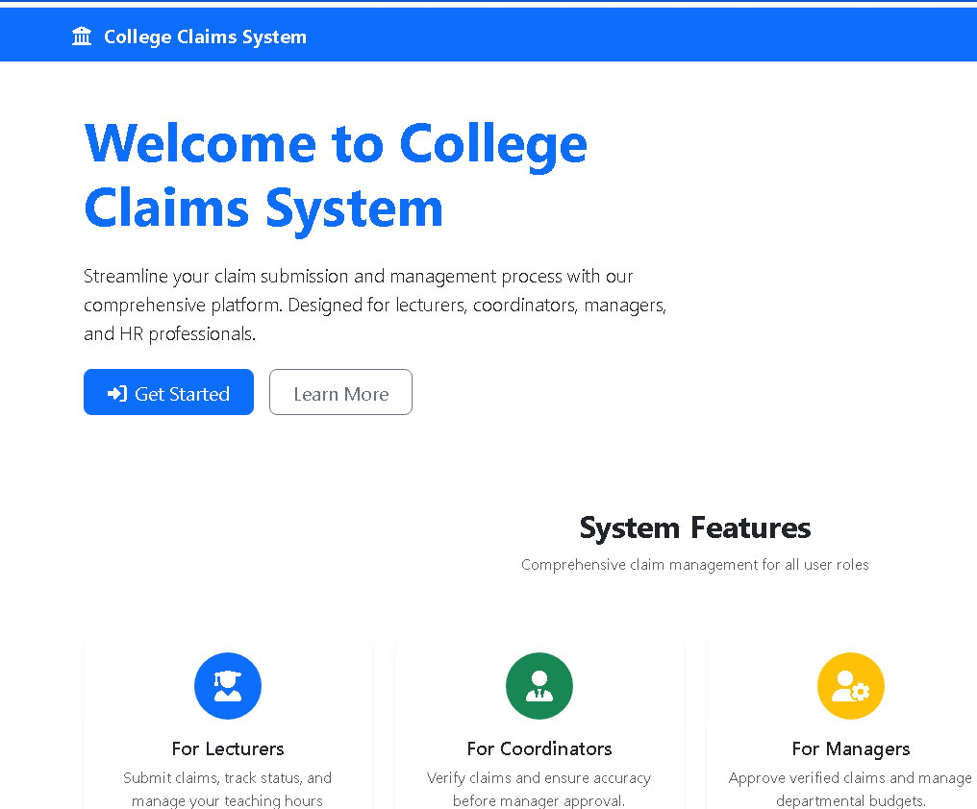
Home Page
This is the home page of the project
It has Icons of each user and describes their roles
To login as any of the users click get started and it'll take you to the login page

Slide 4
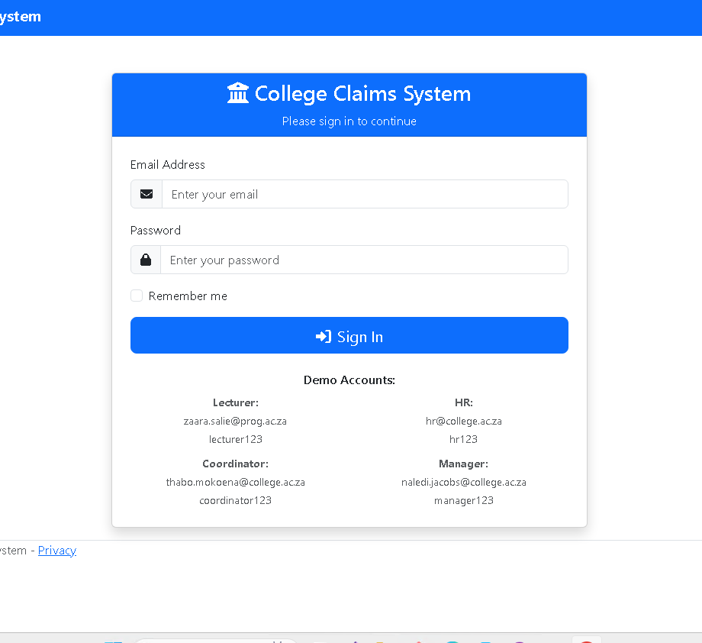
Login Page
This is the login page
This is where the page will take you after you click get started
The user inputs their email and password to log in to their account
I've included the demo users in the view as well as their passwords to make it easier to the marker to test run each user's login
It will produce an error should the wrong details be inputted

Slide 5
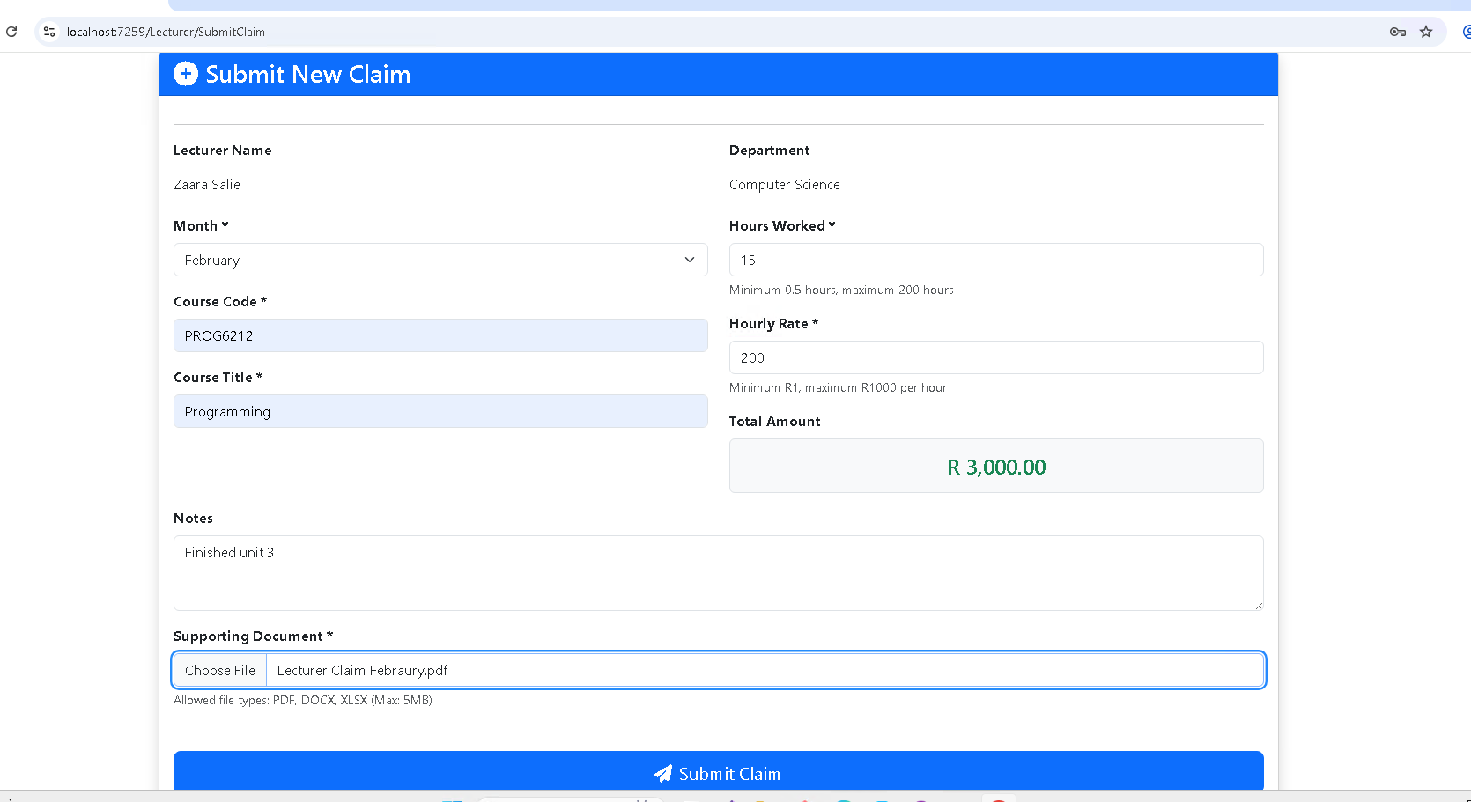
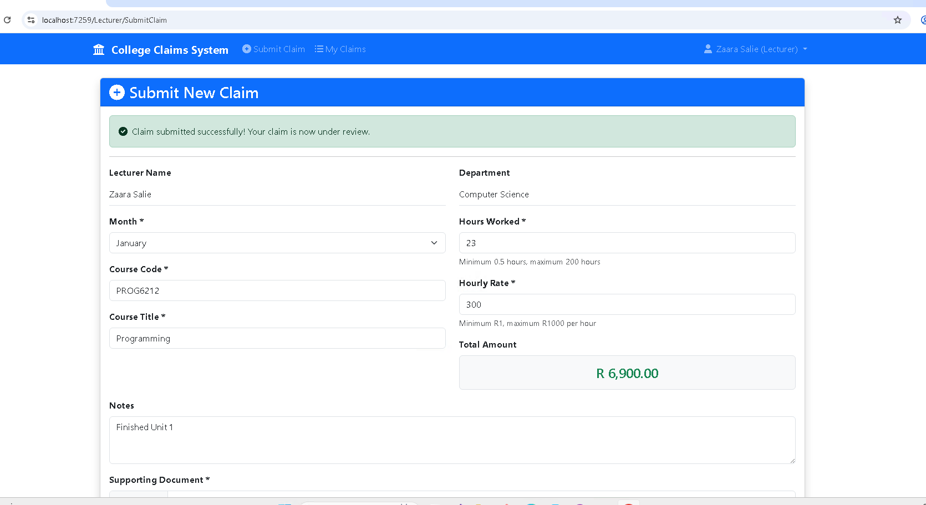
Lecturer Submit Claim and Login
After entering the login credentials for lecturer, it will take you here to fill in and submit your claim
There's automation that will show the amount the lecturer will receive for the number of hours they worked
They are required to submit a document that supports their claim
Lastly, they click submit claim to submit their claims
It will then show a notification that the claim has been submitted successfully as shown in the second image

Slide 6
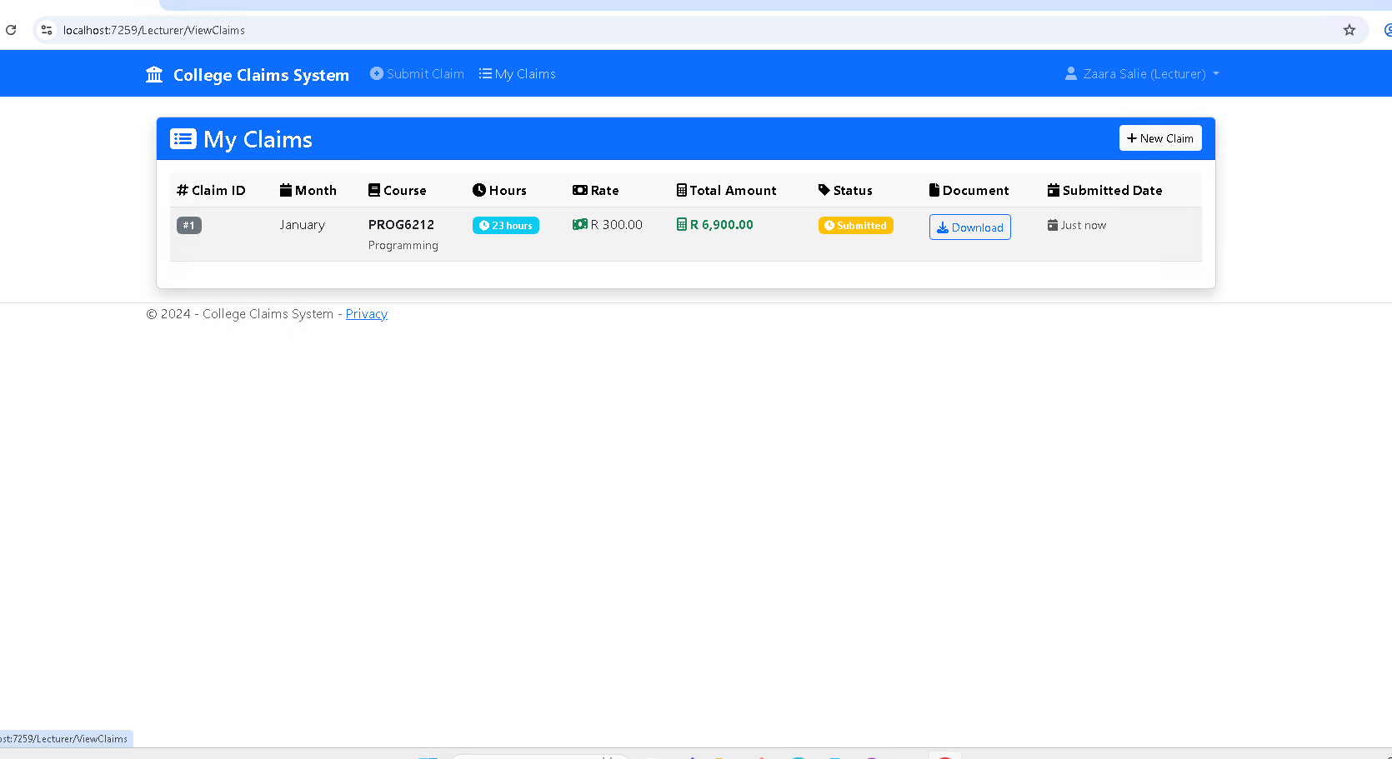
Lecturer claims
The user can view their claims by clicking my claims on top
It'll then display all the claims they made as well as the status of each one in real time
It also prompts the user to submit a new claim
The user can also download a copy of the claim they've submitted

Slide 7
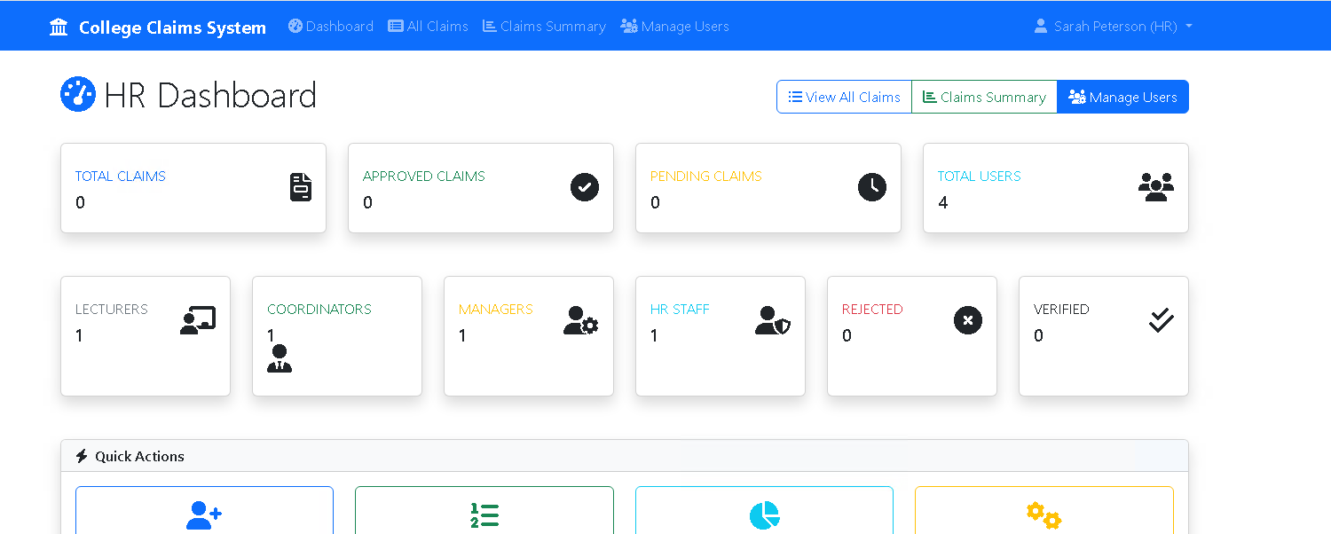
HR Views
This is how the HR user's view will look like after they've logged in
They are able to add, delete and edit users
They can view claims, number of users for each role, and status of all claims as well as the summaries for the claims

Slide 8
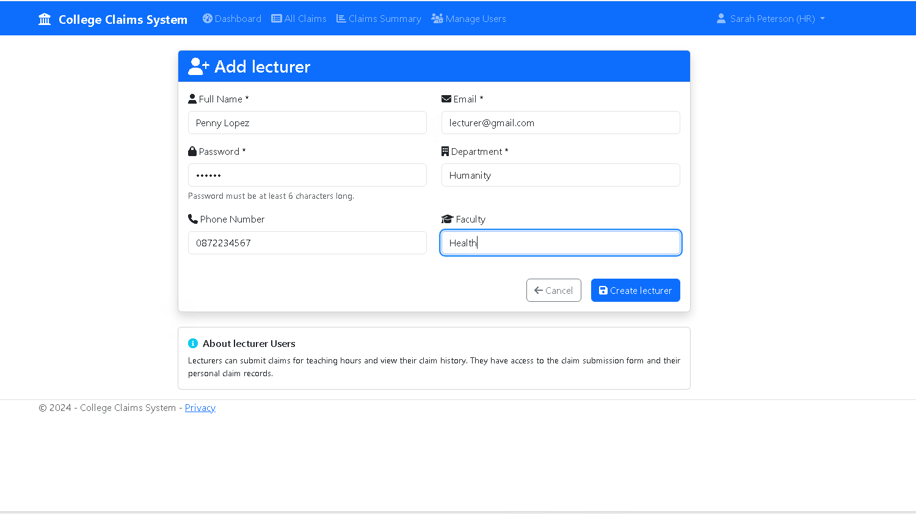
HR Creating new users
HR is adding a new lecturer
This all the necessary information that needs to be inserted when creating a new user
When the user clicks create it will take them back to the dashboard and a notification will be displayed indicating that a user has been successfully created

Slide 9
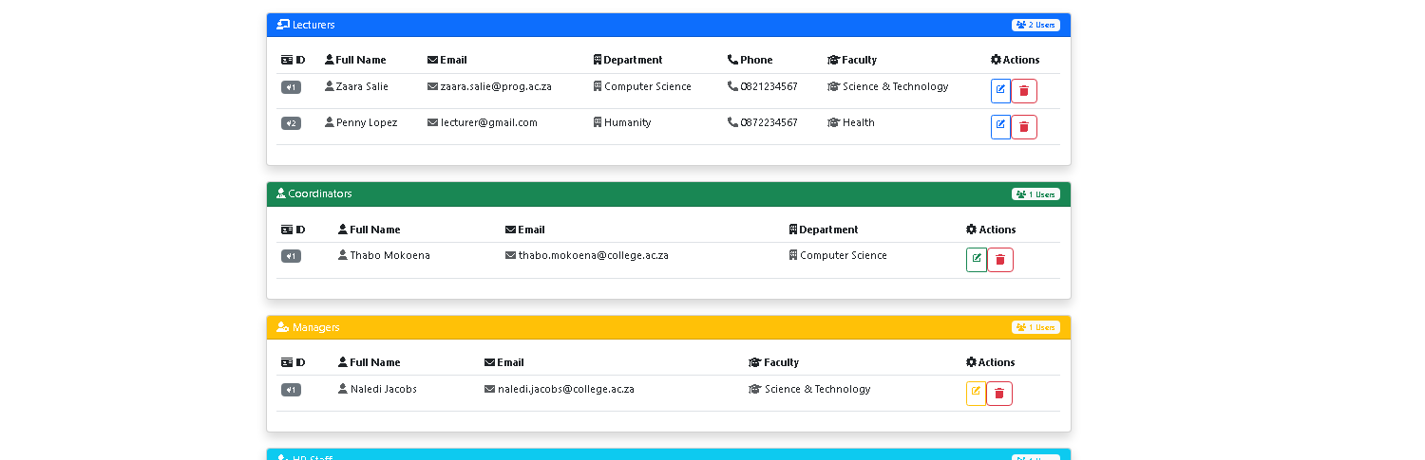
HR Viewing and editing users
The user can see all the users and either edit or delete each user

Slide 10
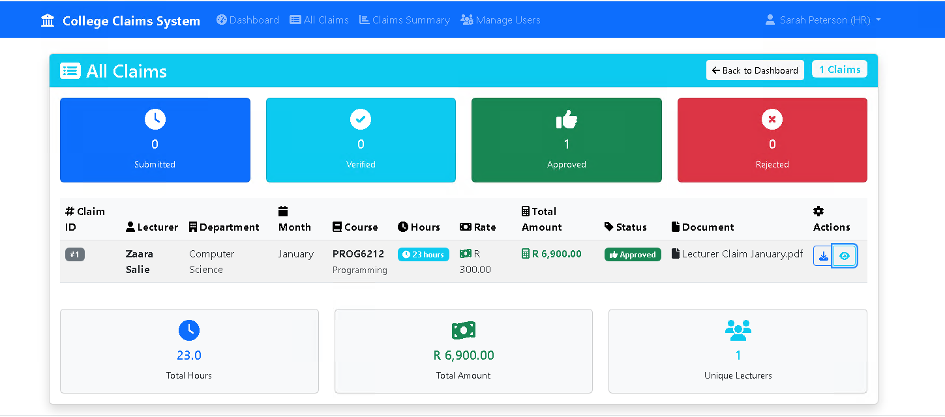
HR Viewing Claims
The user can see all the claims made

Slide 11
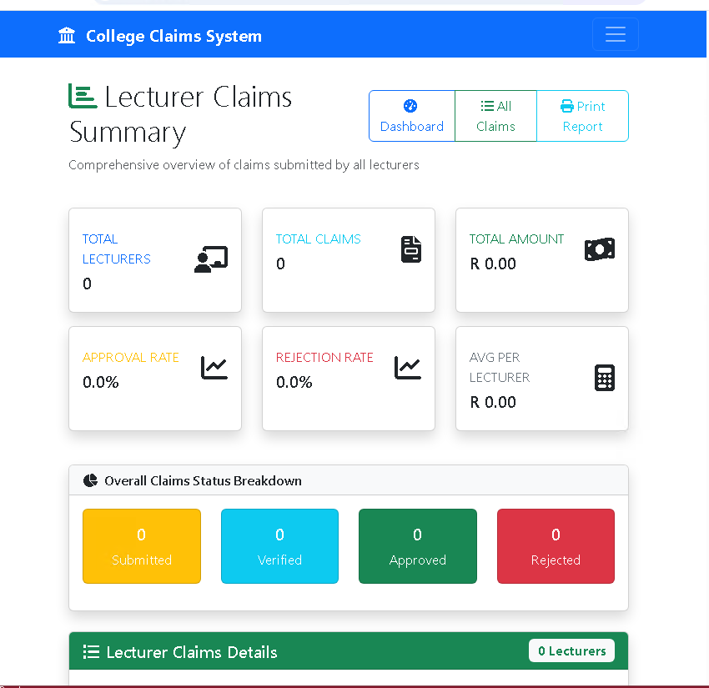
HR Viewing Lecturer Claims Summary
The user can view a summary of all the claims each lecturer submits
They can view the average, approval and rejection rate as well the total amount and overall breakdown of the claims

Slide 12
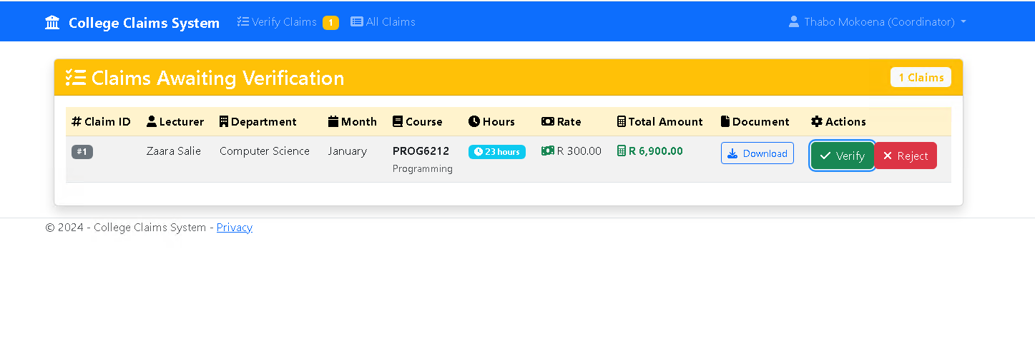
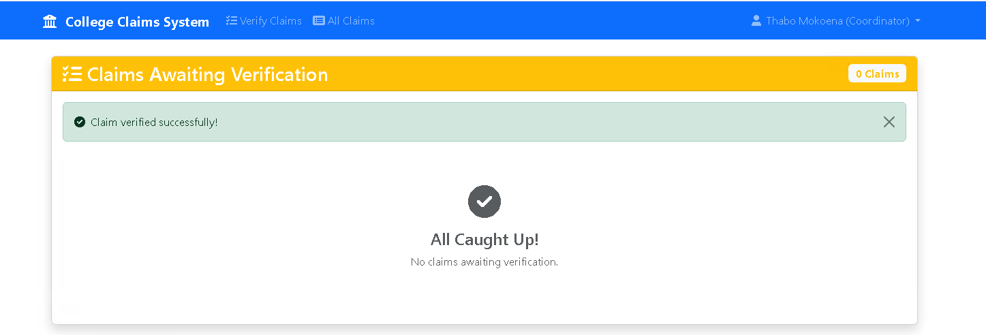
Coordinator View
Coordinator can verify or reject claims
Once they approve or reject a notification will appear notifying them that it's been proccessed

Slide 13
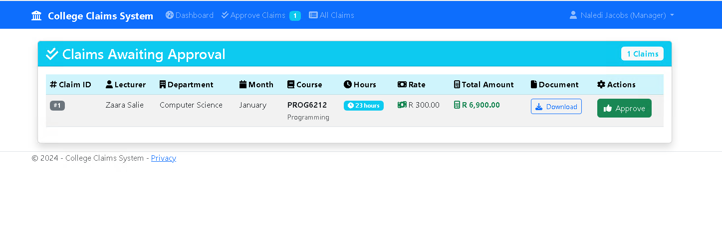
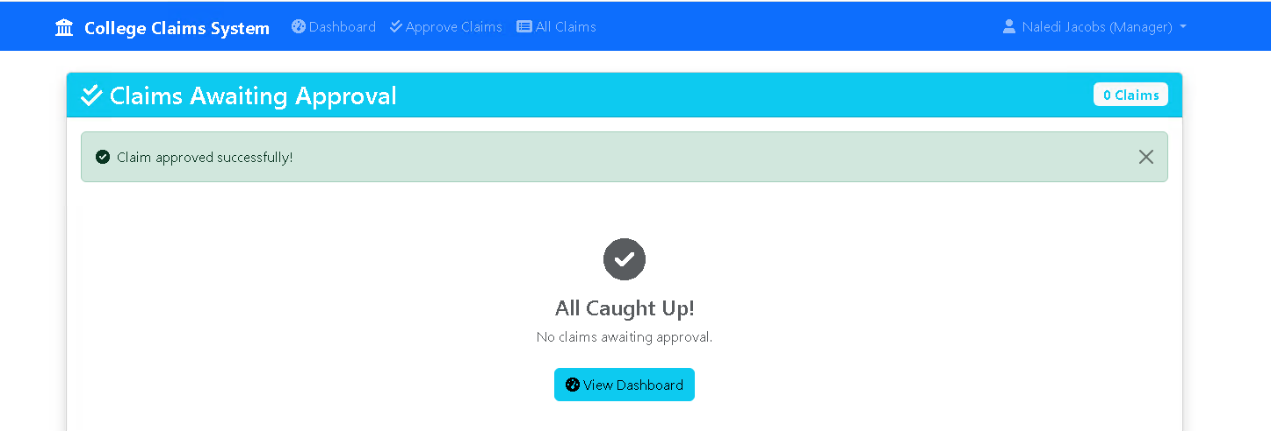
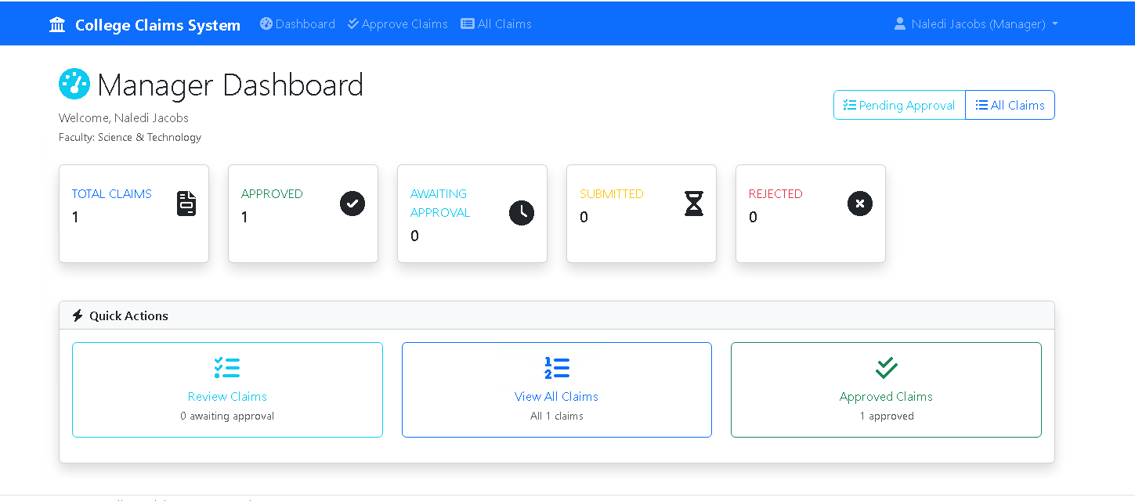
Manager View
Managers can approve claims
Once they approve a notification will appear notifying them that it's been processed
The manager also has a dashboard to view any pending claims which ones are approved and rejected

Slide 14


Delivering with confidence
GitHub And YouTube Links
GitHub Link- https://github.com/ZSalie/PROG6212_PART3_St10455456_POE.git
YouTube Link-

Slide 15
References
Microsoft (2023) ASP.NET Core documentation, Available at: https://learn.microsoft.com/en-us/aspnet/core/ (Accessed: 15 January 2024).
Microsoft (2023) Entity Framework Core, Available at: https://learn.microsoft.com/en-us/ef/core/ (Accessed: 15 January 2024).
Bootstrap Team (2023) Bootstrap 5.3 documentation, Available at: https://getbootstrap.com/docs/5.3/ (Accessed: 15 January 2024).
Font Awesome (2023) Font Awesome icons, Available at: https://fontawesome.com/icons (Accessed: 15 January 2024).
jQuery Foundation (2023) jQuery API documentation, Available at: https://api.jquery.com/ (Accessed: 15 January 2024).
Chart.js Team (2023) Chart.js documentation, Available at: https://www.chartjs.org/docs/latest/ (Accessed: 15 January 2024).
ECMA International (2023) ECMAScript 2023 language specification, Available at: https://www.ecma-international.org/publications-and-standards/standards/ecma-262/ (Accessed: 15 January 2024).
World Wide Web Consortium (2023) HTML Living Standard, Available at: https://html.spec.whatwg.org/ (Accessed: 15 January 2024).
World Wide Web Consortium (2023) CSS Snapshot 2023, Available at: https://www.w3.org/TR/css-2023/ (Accessed: 15 January 2024).
xUnit.net (2023) xUnit.net documentation, Available at: https://xunit.net/ (Accessed: 15 January 2024).
Microsoft (2023) Unit testing in .NET, Available at: https://learn.microsoft.com/en-us/dotnet/core/testing/ (Accessed: 15 January 2024).
OWASP Foundation (2023) OWASP Cheat Sheet Series, Available at: https://cheatsheetseries.owasp.org/ (Accessed: 15 January 2024).
Microsoft (2023) ASP.NET Core security documentation, Available at: https://learn.microsoft.com/en-us/aspnet/core/security/ (Accessed: 15 January 2024).
Microsoft (2023) Visual Studio 2022 documentation, Available at: https://learn.microsoft.com/en-us/visualstudio/ide/ (Accessed: 15 January 2024).
.NET Foundation (2023) .NET 7 SDK, Available at: https://dotnet.microsoft.com/en-us/download/dotnet/7.0 (Accessed: 15 January 2024).
Microsoft (2023) ASP.NET Core MVC pattern, Available at: https://learn.microsoft.com/en-us/aspnet/core/mvc/overview (Accessed: 15 January 2024).
Gamma, E. et al. (1994) Design patterns: elements of reusable object-oriented software, Boston: Addison-Wesley.
Martin, R.C. (2008) Clean code: a handbook of agile software craftsmanship, Upper Saddle River: Prentice Hall.
Fowler, M. (2002) Patterns of enterprise application architecture, Boston: Addison-Wesley.
Beck, K. (2002) Test-driven development: by example, Boston: Addison-Wesley.
Evans, E. (2003) Domain-driven design: tackling complexity in the heart of software, Boston: Addison-Wesley.
Internet Engineering Task Force (2023) *HTTP/1.1 specification (RFC 9112)*, Available at: https://httpwg.org/specs/rfc9112.html (Accessed: 15 January 2024).
World Wide Web Consortium (2023) Web Content Accessibility Guidelines (WCAG) 2.2, Available at: https://www.w3.org/TR/WCAG22/ (Accessed: 15 January 2024).
Information Commissioner's Office (2023) Guide to the UK General Data Protection Regulation (UK GDPR), Available at: https://ico.org.uk/for-organisations/guide-to-data-protection/guide-to-the-general-data-protection-regulation-gdpr/ (Accessed: 15 January 2024).
European Union (2016) General Data Protection Regulation (GDPR), Official Journal of the European Union, L119/1.
Microsoft (2023) C# coding conventions, Available at: https://learn.microsoft.com/en-us/dotnet/csharp/fundamentals/coding-style/coding-conventions (Accessed: 15 January 2024).
GitHub (2023) GitHub Flow, Available at: https://docs.github.com/en/get-started/using-github/github-flow (Accessed: 15 January 2024).
Newtonsoft (2023) Json.NET documentation, Available at: https://www.newtonsoft.com/json (Accessed: 15 January 2024).
Moq Project (2023) Moq documentation, Available at: https://github.com/moq/moq (Accessed: 15 January 2024).
University of South Africa (2023) PROG6212: Programming course materials, Pretoria: UNISA.
Stack Overflow (2023) Stack Overflow community knowledge base, Available at: https://stackoverflow.com/ (Accessed: 15 January 2024).
Chacon, S. and Straub, B. (2014) Pro Git, 2nd edn, New York: Apress.
Git (2023) Git documentation, Available at: https://git-scm.com/doc (Accessed: 15 January 2024).

